Slide 1
Dragon Hunter
Ian Kinghorn Addison Griffin
Sean Welch Rachael Little
Jayson Wu Rose Little
Matthew Blethen Dillon Stokes
Frank Sicurella Tyrone Fordham
Mitchell Howell Patrick Silvia

Slide 2
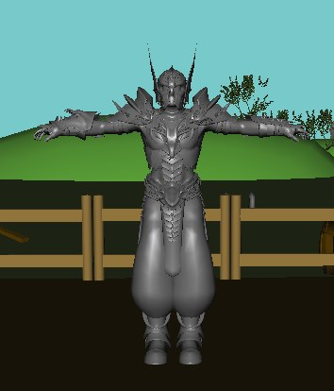
Barbarian
The Barbarian is the playable character in Dragon Hunter.
He is a well defined and extremely muscular man who wields a massive battle axe.

Slide 3
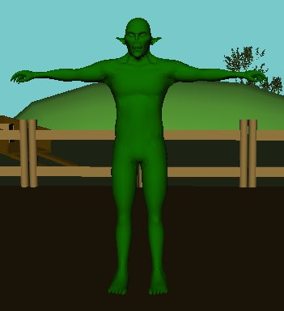
Orc
Orcs are the games’ basic melee enemy.
They are easy alone, but lethal in large packs.

Slide 4
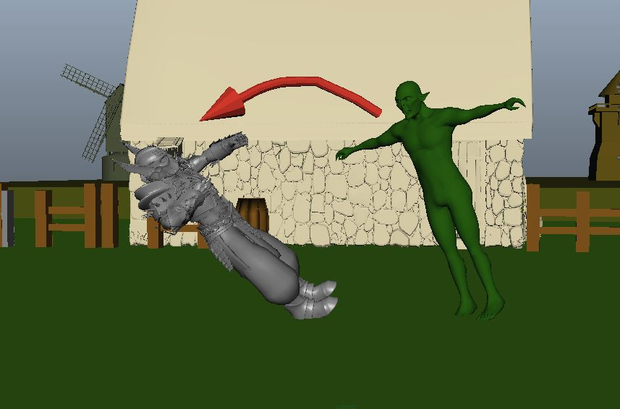
Orc Attack

Slide 5
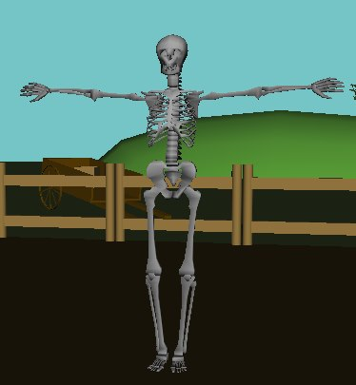
Archer
Skeletons are the games’ basic ranged enemy.
These should be high priority because their damage per second is high and can be lethal to the player.

Slide 6
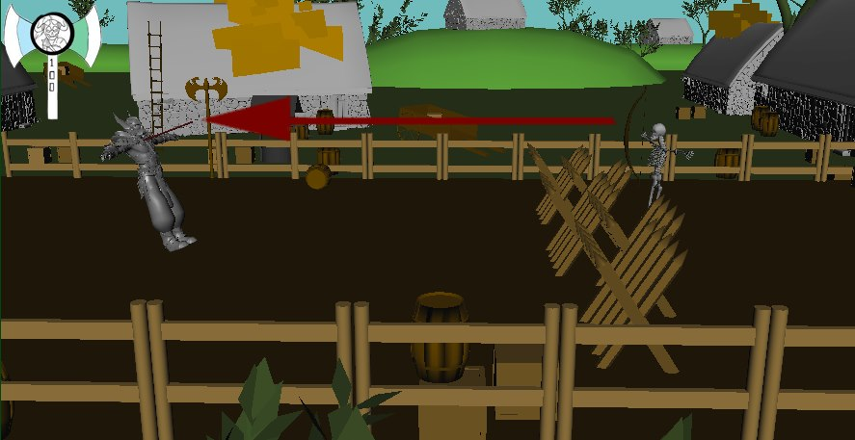
Archer attack

Slide 7
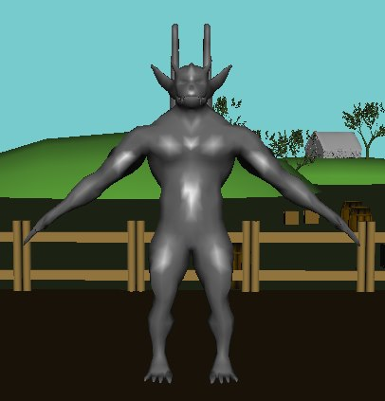
Troll
Trolls are the largest of the common enemy types.
They are massive and vicious creatures which are nearly indestructible as long as their tough armor protects them.
To bring down their armor you must dash through them until it breaks.

Slide 8
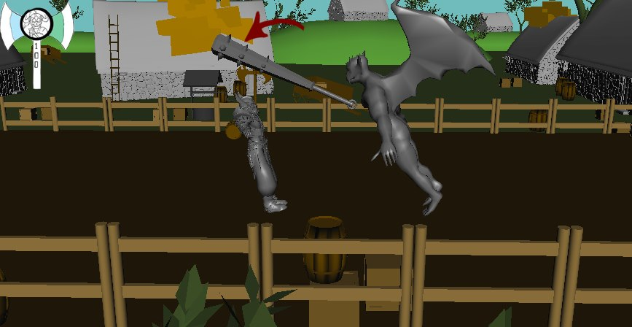
Troll Attack

Slide 9
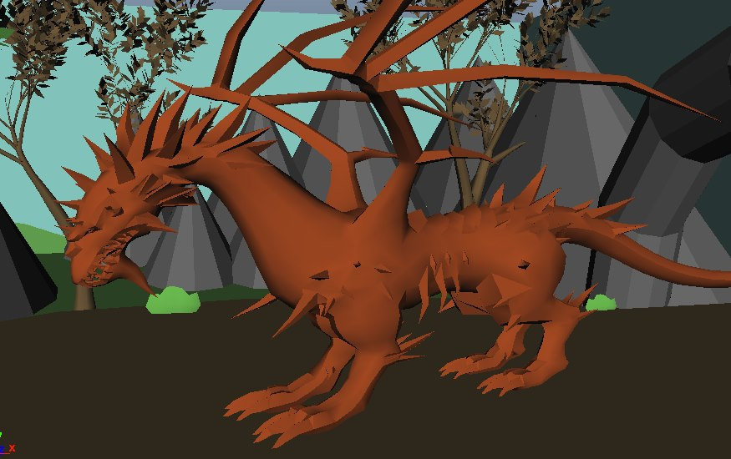
Dragon
Large, undead, regenerating dragon.
This is the games’ final boss.
He has three stages.

Slide 10
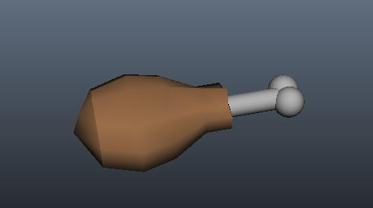
Items - Food
Used to restore health to the player.

Slide 11
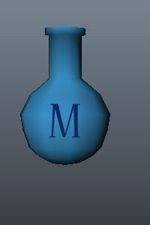
Items - Mead
Used to restore mana to the player.

Slide 12
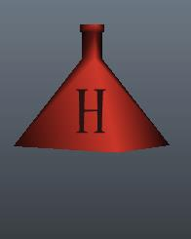

Items - Modifiers
Used to grant temporary buffs to the player.

Slide 13
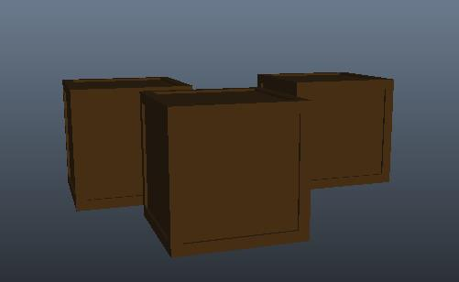
Boxes
Breakable objects that can contain food and mead.

Slide 14
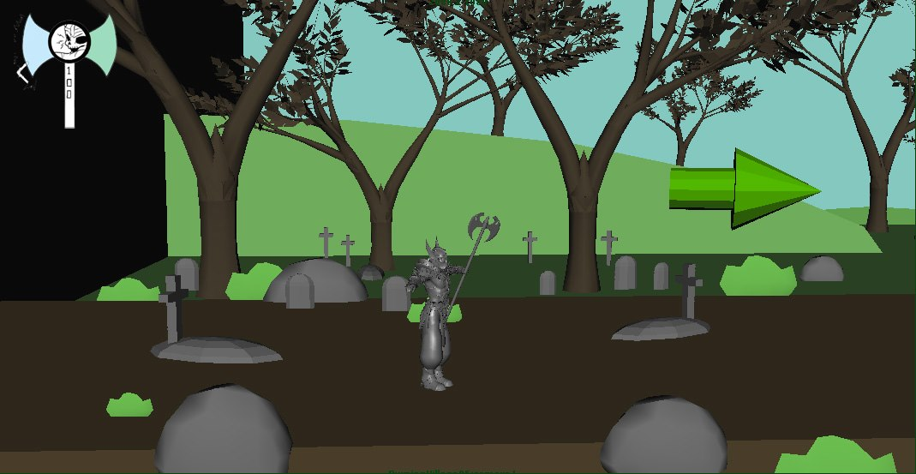
Intro Raise
Static camera in the graveyard on Nanoc’s grave.
Player does not have control
Nanoc is resurrected by a mysterious witch.
Sounds of rustling dirt and bones crackling.
Sounds of magic.

Slide 15
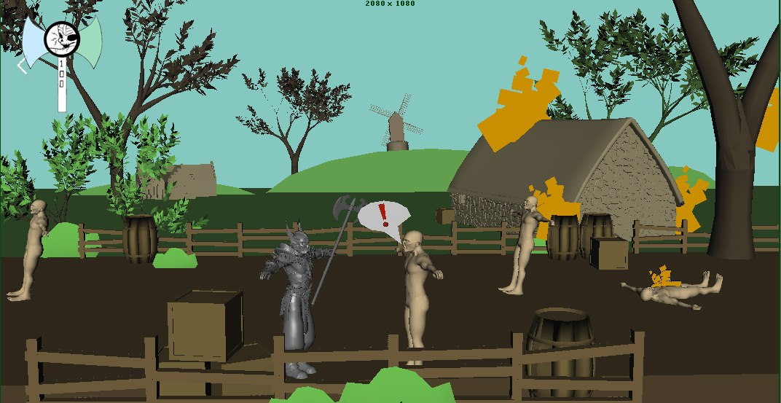
Intro Emerge
Camera pans around the burning village.
Nanoc emerges from graveyard.
Sound of villagers screaming, fire
Sound of crumbling buildings, feet fleeing.

Slide 16
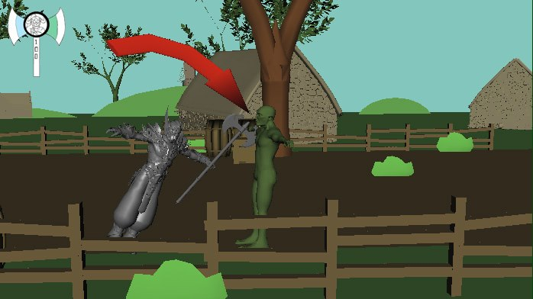
Intro Melee
Player is introduced to basic attacking
Player moves towards Orc
Player attacks Orc and Orc attacks Player
Player sees affect of hitting each other
Player’s health goes down
Player’s mana goes up
<-
->
Movement
Q
Melee

Slide 17
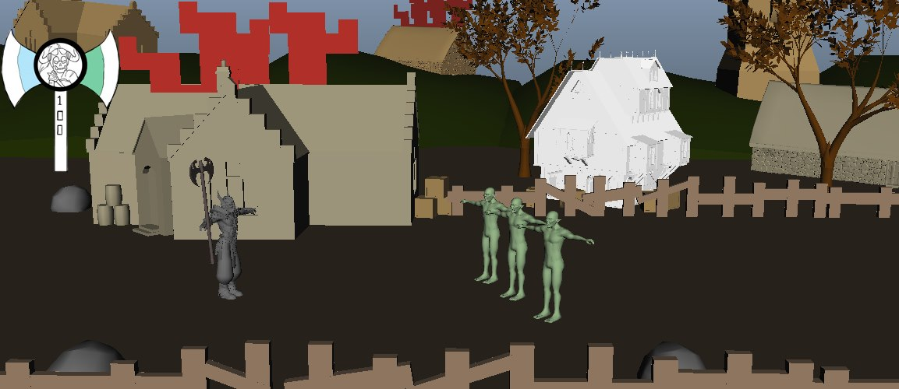
Advanced Melee
<-
->
Movement
Group of 3 Orcs comes at the player
Player attacks Orcs – Orcs attacks Player
Players hits multiple enemies
More health lost, more mana gained
Q
Melee

Slide 18
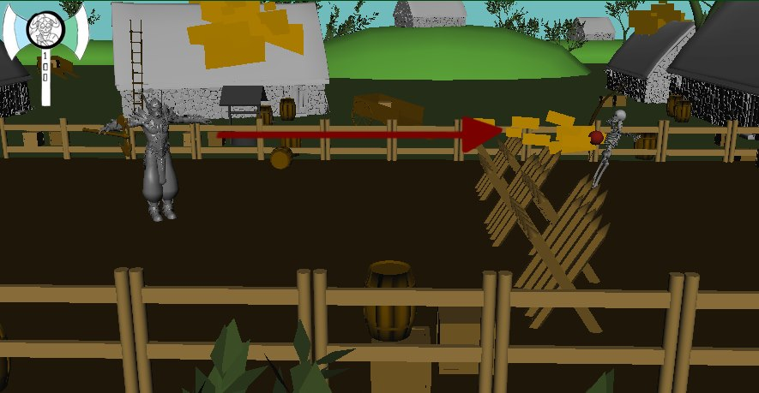
Intro Range
<-
->
New screen has an archer behind a barricade
Player cannot move through barricade and attacking it does nothing
Archer shoots player with arrow
Player loses health
Player shoots fireball, mana goes down
Fireball goes over barricade and hits archer
When hit enough, archer dies and barricade breaks.
Movement
W
Magic

Slide 19
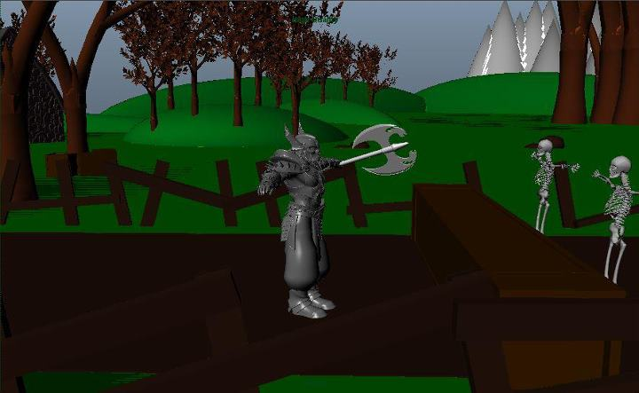
Advanced Range
<-
->
Two archers move onto the screen behind barricade
Player shoots Fireball, mana goes down
Both archers are hit When both archers are hit enough, they die.
Arrow appears telling the player to move on
Movement
W
Magic

Slide 20
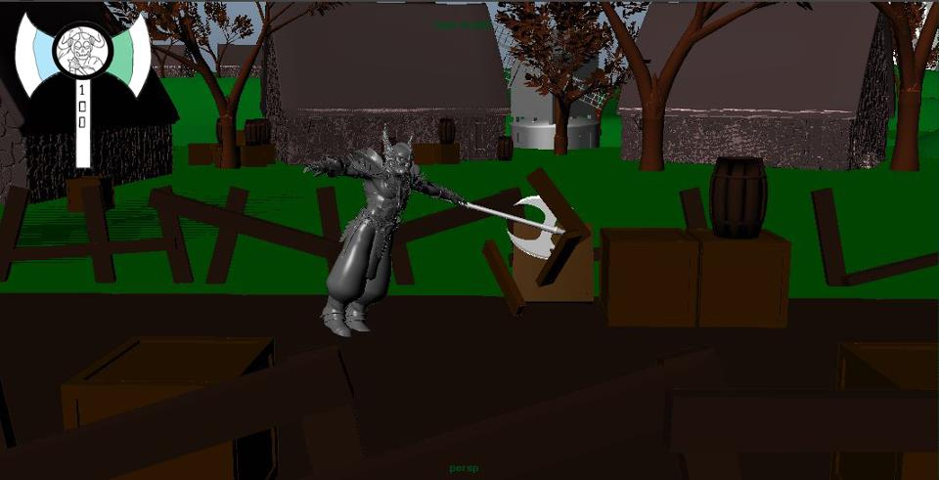
Acquiring Items
<-
->
Movement
Player busts down boxes with melee to move on.
In one of the boxes, a pickup will drop.
Drops can consist of:
Food
Mead
Q
Melee

Slide 21
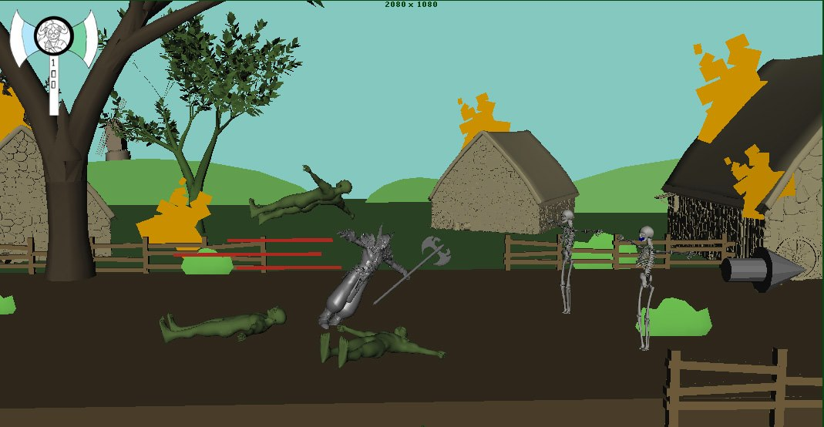
Intro Dash
<-
->
Movement
W
Dash
Q
Melee
3 Orcs and 2 Skeletons
Player must use dash to bash through group of orcs and get to archers.
Once there must take out archers quickly and then can go back to fighting orcs.

Slide 22
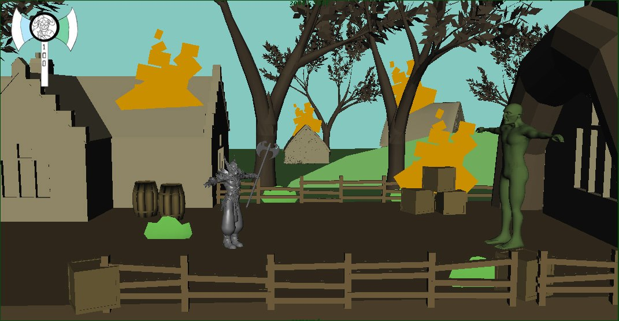
Dash Part 2
<-
->
Movement
W
Dash
Q
Melee
1 Troll
Player must use dash multiple times to bash into troll and break his armor before attacking with melee.
Once trolls armor has been broken, you will be able to attack him with melee or magic and kill him in his “weakened’ state.
The troll will 100% drop a modifier after being defeated in this scenario.

Slide 23
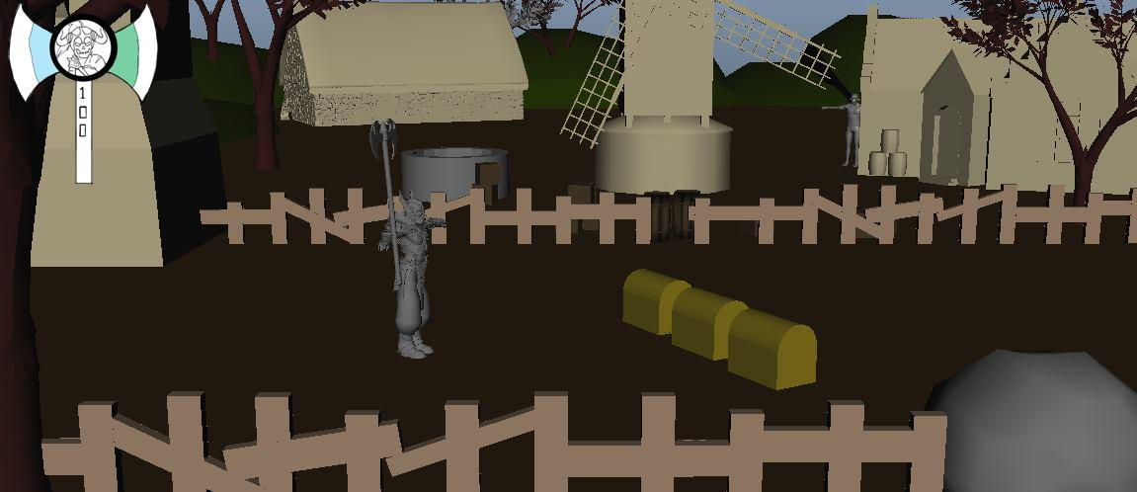
Select the chest (Level Up)
<-
->
Movement
You now have enough experience to level up and three chests lay before you. Each with a different type: Magic, Melee, and Dash.
Once you have selected one, it will upgrade your skills that the selected chest correlates with.
As you progress, player’s spell effects will change.
Player melee’s the chest of their choice.
Q
Melee

Slide 24
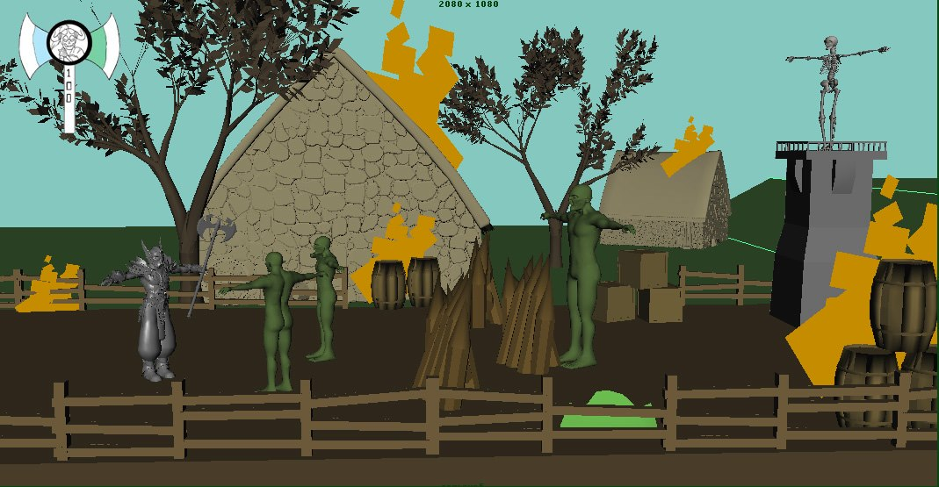
Burning Village Part 1
<-
->
Movement
Q
Melee
W
Magic
Player encounters first challenging obstacle. 2 Orcs, 1 Troll, Archer Tower.
Player must do this in however order they want, but must kill orcs, break down blockade, kill troll, and shoot fireball at skeleton tower to bring down the tower to kill the skeleton.
R
Dash

Slide 25
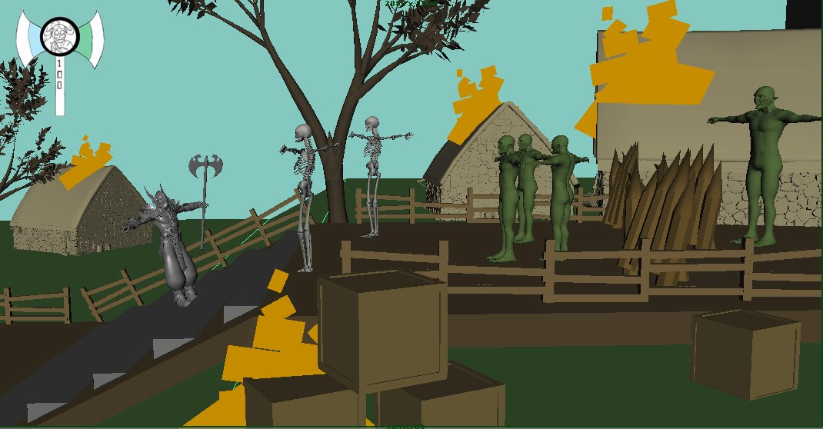
Burning Village Part 2
<-
->
Movement
Q
Melee
W
Magic
Player must dash up stairs while skeletons shoot down at him.
Once there must fight and kill the orcs and then can destroy blockade to kill the troll.
R
Dash

Slide 26
Select the chest 2 (Level Up)
<-
->
Movement
You now have enough experience to level up and three chests lay before you. Each with a different type: Magic, Melee, and Dash.
Once you have selected one, it will upgrade your skills that the selected chest correlates with.
Player melee’s the chest of their choice.
Citizen shouts out his thanks in background, and tells you about the enemies in the forest up ahead.
Burning Village transitions into Evil Forest.
Q
Melee

Slide 27
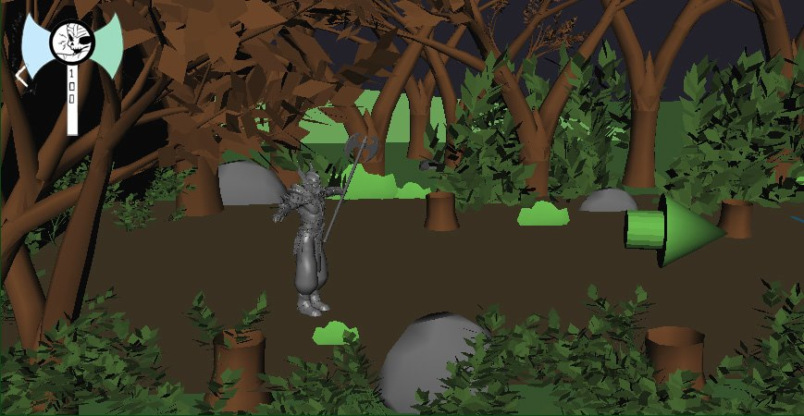
Evil Forest
Player begins to move into forest and head to the enemy blockade ahead.
<-
->
Movement

Slide 28
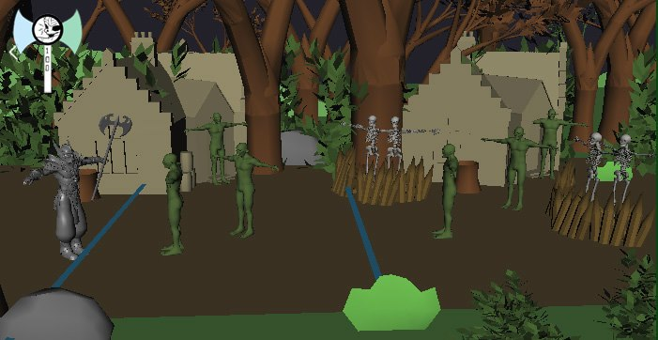
Evil Forest Part 1
<-
->
Movement
Q
Melee
Player encounters new obstacles – Orc Bunkers. When player appears nothing but archers are present, but once you pass the trigger lines the orcs run out of bunkers and attack.
Player must use combination of knowledge to kill the enemies here.
W
R
Magic
Dash

Slide 29
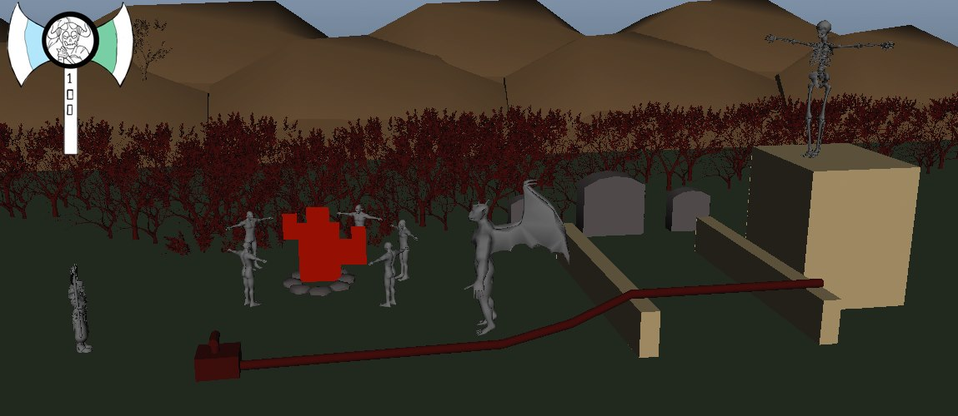
Evil Forest Part 2
<-
->
Movement
Q
In this encounter, the player sees that 5 Orcs are standing around a fire with a troll. A skeleton archer also is posted behind tall walls that are not able to be shot over by magic.
Player takes out Orcs and trolls with combination of skills while dodging archer arrows.
Once melee enemies have been dealt with, player will notice TNT blaster with fuse wire attacked to it leading to walls.
Once attacked with melee, it will detonate killing archer and blowing way through to progress.
Melee
W
R
Magic
Dash

Slide 30
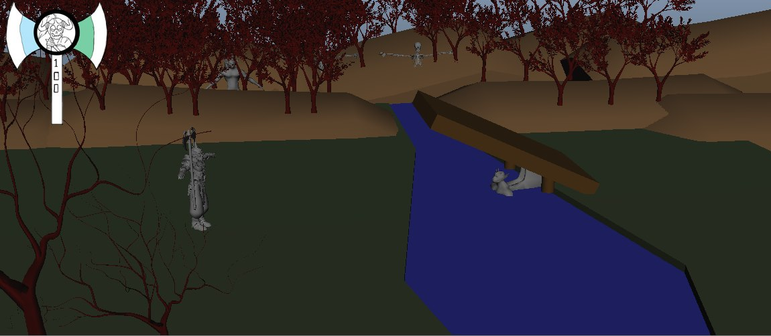
Forest Part 3
<-
->
Movement
W
Magic
In this encounter, the player will notice a peaceful scene with a flowing river with a raised bridge.
Player must shoot bridge with magic to make it drop down to progress forward.

Slide 31
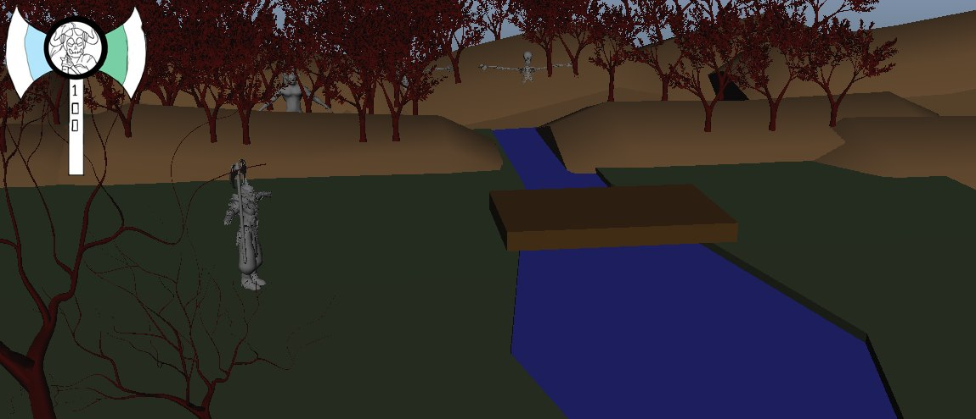
Forest Part 3-2
<-
->
Movement
W
Magic
Once bridge is down and player runs across he is ambushed on both sides by enemies and must take them down with combination of knowledge.
The enemies in the background will move into the foreground and attack.
Q
Melee
R
Dash

Slide 32
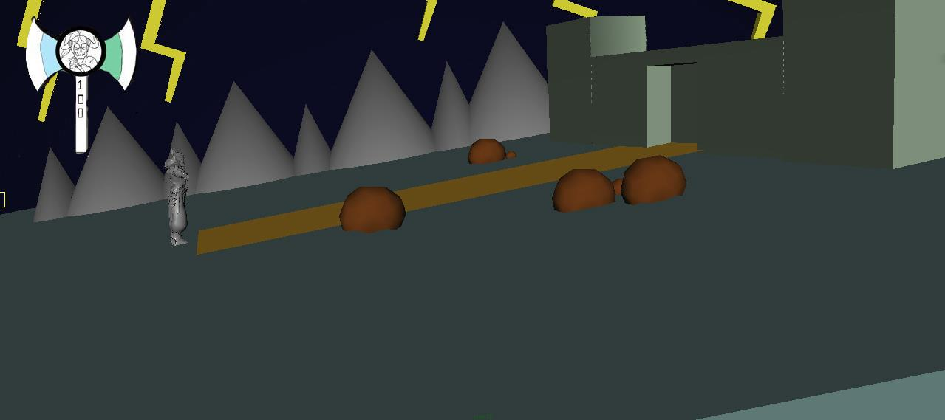
Summit 3-1
<-
->
Movement
The Summit Gate is the first area onto the mountain.
Player must use melee to bash open the gate to move onwards up the Mountain Summit.
The Summit Gate is a demented looking ancient gate that clearly leads to a lost and forsaken Mountain Peak where the dragon lives.
Q
Melee

Slide 33
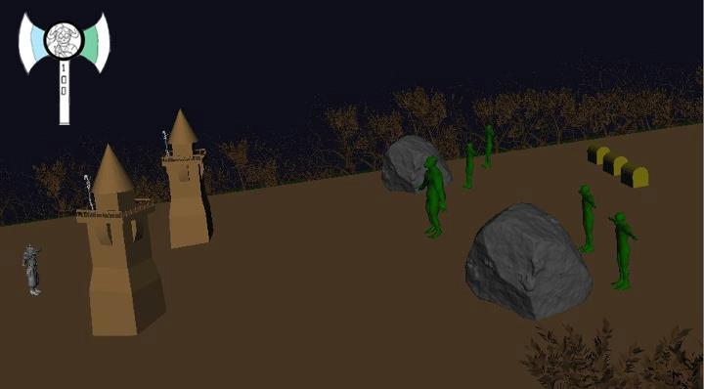
Summit 3-2
<-
->
Movement
Q
Melee
W
Magic
E
Dash
Once you enter the gates you begin heading up the mountain to the first blockade.
As you head up the mountain you will see the forest far down below in the backdrop as you head higher and higher in altitude to the peak.
In this scene you will approach multiple units in towers and hiding behind rocks waiting for your arrival.

Slide 34
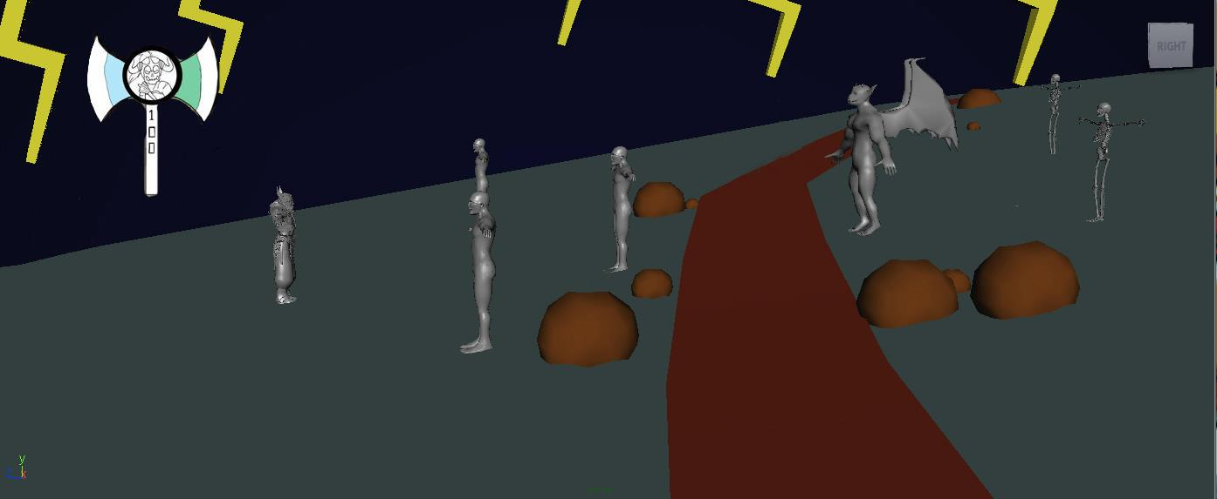
Summit 3-3
<-
->
Movement
Q
Melee
W
Magic
E
Dash
The sky darkens and the lightning intensifies. In this scene a river of Lava flows viciously forward and will cook your flesh if you touch it. Player must take out the enemies on his/her side of the river.
Melee on the rock pile will knock them over to create bridge across lava. Once across you can take out the other enemies.

Slide 35
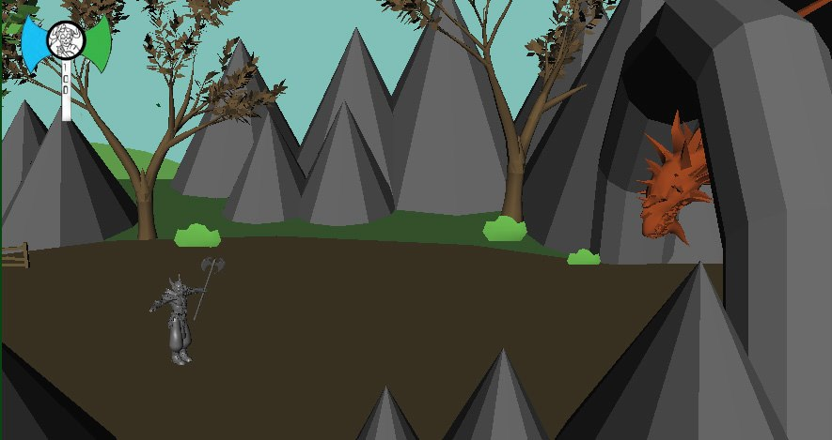
Dragon’s Peak
<-
->
You approach the mountain peak, which here you will battle the Evil Dragon King.
The player will temporarily lose control of the game as the camera pans over to reveal the Dragon approaching out of the depths of his cave.
The ground shakes and trembles before his awesome presence.
Movement

Slide 36
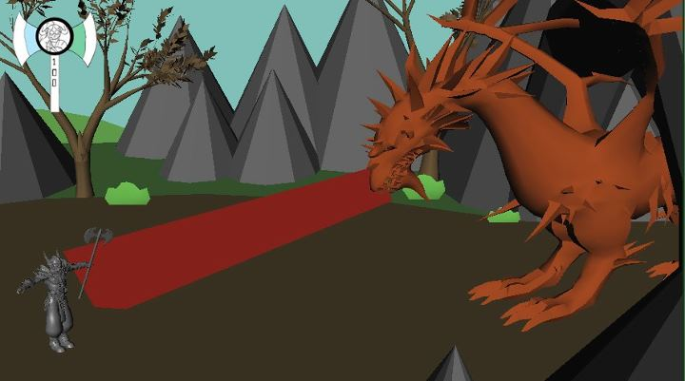
Dragon Phase One
<-
->
Movement
Q
Melee
W
Magic
E
Dash
During the first phase of Dragon Fight, you will have to deal with his Fire Breath. During this phase he will shoot fiery breath at you which you must run up or down in the depth of the game to avoid.
During the pre-phase where the dragon is gathering in his deep breath, you must strike his chest to hurt him.

Slide 37
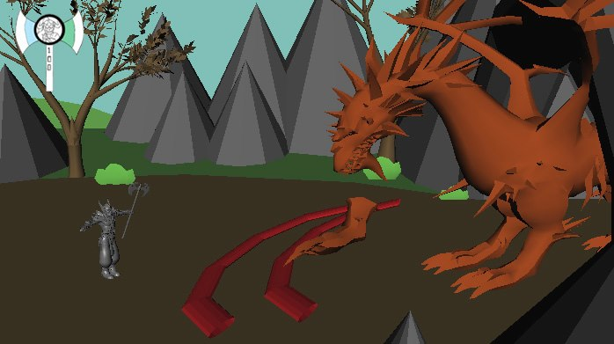
Dragon Phase Two
<-
->
Movement
Q
Melee
W
Magic
E
Dash
During this phase of the Dragon Fight – he will use his massive claws to swipe at you will also using his fire breath occasionally.
You must still attack him in the pre-phase before fire breath.

Slide 38

Dragon Phase Three
<-
->
Movement
Q
Melee
W
Magic
E
Dash
During the third and final phase of the Dragon Fight – you will have to deal with adds. The boss will drop his jaw and regurgitate orcs that will charge out to kill you.
You must deal with these creatures before you can fight the boss or you will be killed most likely by the shear number of enemies that can over-whelm you.

Slide 39
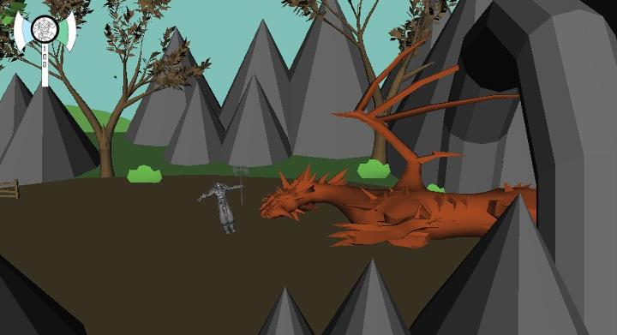
Dragon Death
Upon the dragons’ death, the player will lose control of his character and the splash screen will come up informing you of victory over your conquest to slay the Dragon King.
After they go through this the game will be over and they can return to the main menu.

Slide 40
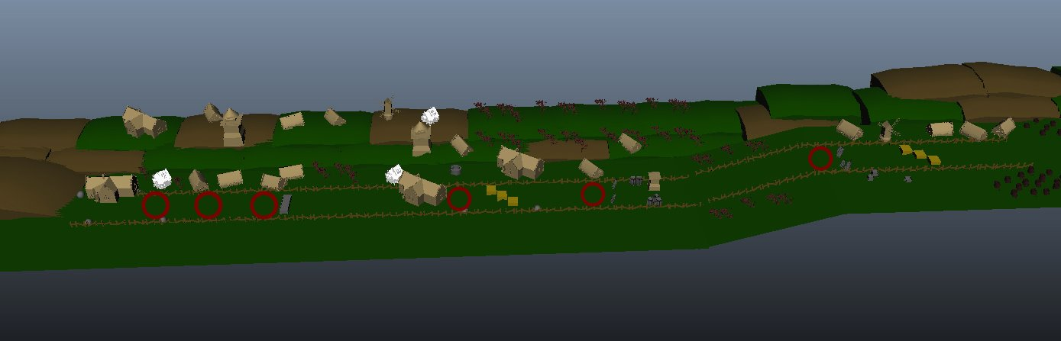
Burning Town
Buildings made of brick, wood, and mortar.
Most buildings are smashed and broken.
Ravaged farmlands occasionally placed around the town.
Wooden fences are placed around all the farmlands.
Smoke filters from fires spread everywhere throughout the village.

Slide 41
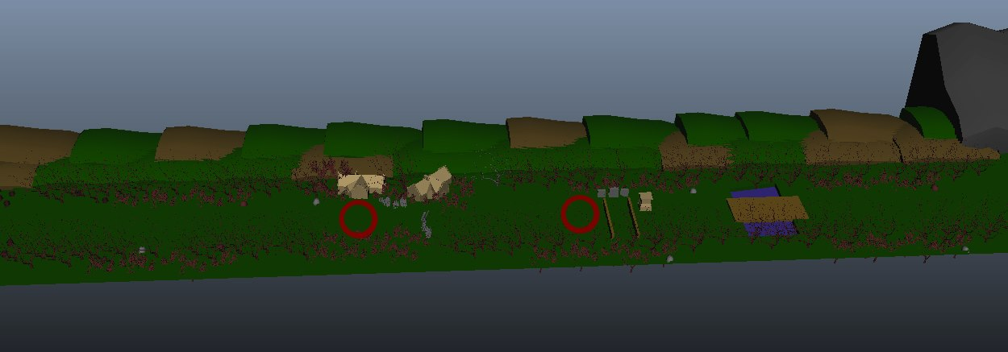
Evil Forest
Mostly comprised of dying trees.
Thorn bushes occupy most of the ground.
A diseased river runs through the center of the forest.
Orc bunkers and wooden barricades are sprawled throughout the forest.
The sky is dark, gray, and cloudy.

Slide 42
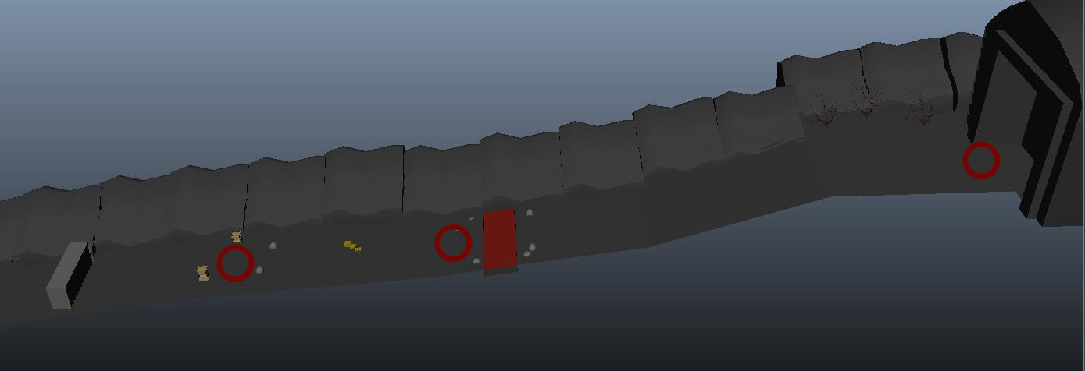
Mountain
Rain falls from the skies, and lightning strikes occasionally.
The sky has gone completely black from the smoke emerging from the dragon’s lair.
Rocks fall from higher up on the mountain from the dragon roaring.
Small caves occupy the lower portion of the mountain, wherein enemies ambush the player.
Large boulders litter the ground, acting as breakable objects.

Slide 43
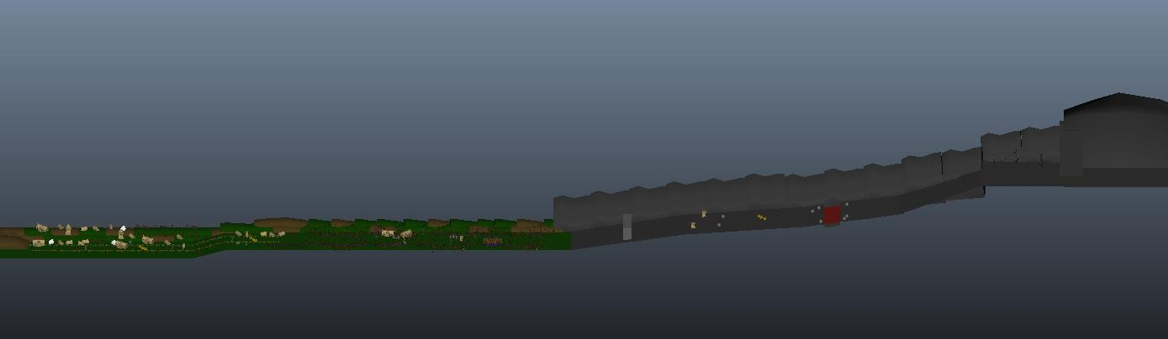
Wulfgarr

